Slide 1
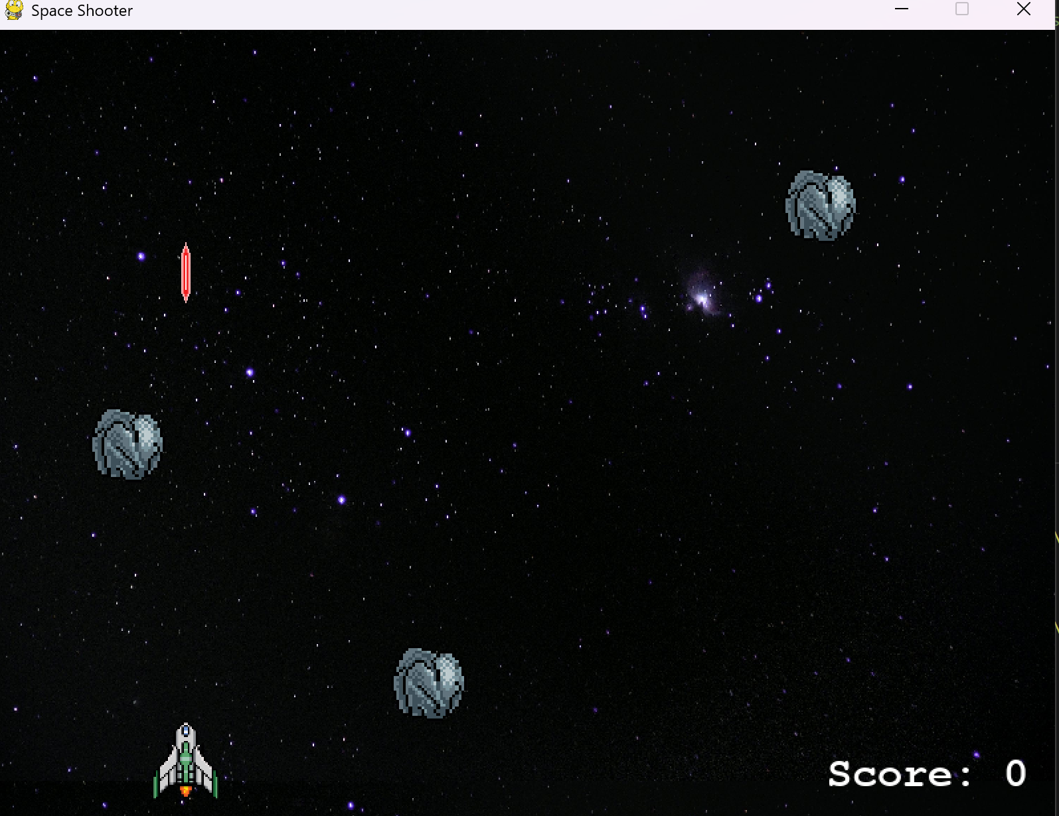
Mini Space Game
By: Joshua Velasquez and Jonathan Yalew
This project is a 2D mini space shooter game built with Python and Pygame. Players control a spaceship, shoot asteroids, and avoid them to survive and score points.

